Slide 1

MATLAB Scripts
Professor Bo Liu
James Watt School of Engineering

Slide 2
MATLAB scripts
Compile multiple lines of MATLAB code into a script
  Reusable.
  Scalable.
  Easier to debug.
  Easier to share.
You have already seen MATLAB live scripts

Slide 3
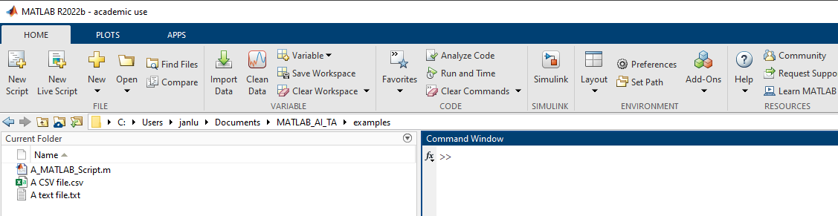
Creating a MATLAB script
Create a new script via the toolbar

Slide 4
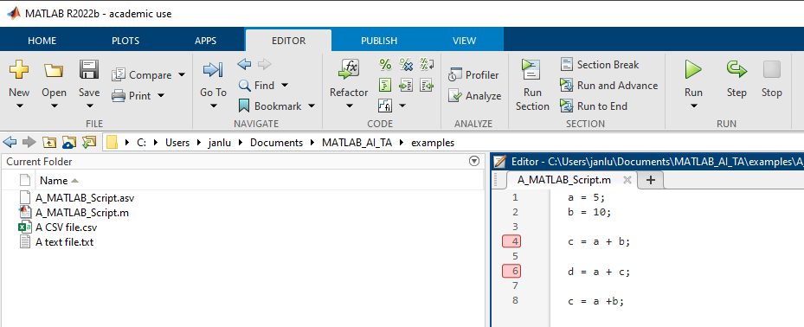
Script layout
Editor toolbar
MATLAB code as a script
Run button
Step button
Save button
Open button
Break points
Saved script

Slide 5
Script layout
Editor toolbar
MATLAB code as a script
Run button
Step button
Save button
Open button
Break points
Saved script

Slide 6
Script layout
Editor toolbar
MATLAB code as a script
Run button
Step button
Save button
Open button
Break points
Saved script

Slide 7
Script layout
Editor toolbar
MATLAB code as a script
Run button
Step button
Save button
Open button
Break points
Saved script

Slide 8
Script layout
Editor toolbar
MATLAB code as a script
Run button
Step button
Save button
Open button
Break points
Saved script

Slide 9
Script layout
Editor toolbar
MATLAB code as a script
Run button
Step button
Save button
Open button
Break points
Saved script

Slide 10
Script layout
Editor toolbar
MATLAB code as a script
Run button
Step button
Save button
Open button
Break points
Saved script

Slide 11
Script layout
Editor toolbar
MATLAB code as a script
Run button
Step button
Save button
Open button
Break points
Saved script

Slide 12
MATLAB Scripts
Scripts tools are found in the “Editor” toolbar
Enter MATLAB code into a blank script
Execute MATLAB code via the “Run” button
MATLAB executes scripts line by line
Save or load MATLAB scripts (.m files) using the “Save” or “Load” buttons
See live script

Slide 13
Debugging MATLAB Scripts
Read the error message and it is usually very helpful
Use the “step” button to execute code one line at a time
View current values of variables in the workspace window
Use breakpoints to pause execution at specific lines
  To add a break point to a line, click the line number.
See a separate video for more details.
See live script

Slide 14




Thanks!
#UofGWorldChangers
@UofGlasgow

Slide 15
Editor toolbar
“Editor” Toolbar
“Open” Button
code as a script
“Run” & “step” Buttons
“Save” Button
Break Points
Saved script file

